Slide 1
Old English words

Slide 2
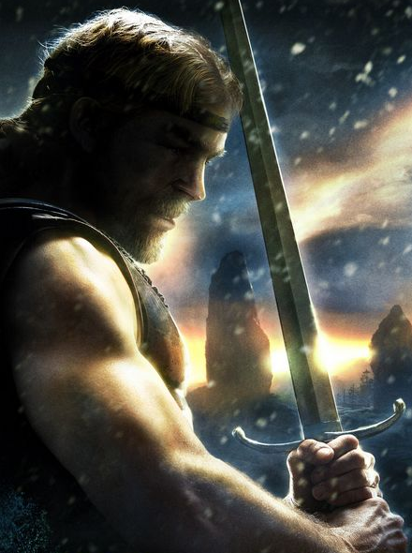
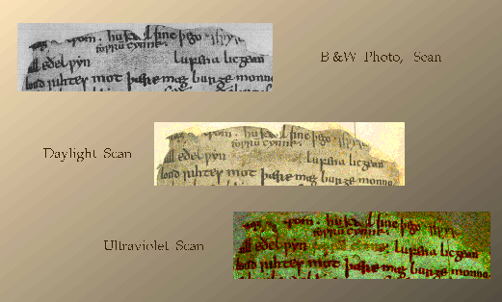
In about AD 1000, the Anglo Saxon scribes, who copied books by hand, produced a copy of the poem that still exists. The copy is very fragile as its pages are a thousand years old, but it is preserved in the British Library in London.
British Library link with podcast and background

Slide 4
It is written in Old English so we would not understand it if we read it today

Slide 5
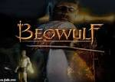
In the Michael Morpurgo Version of this Epic Poem - there are some words which are also unfamiliar to us today
Listen to/or read p13 – 21.
Make a list of some of the unknown or ambitious words used by the author.
Check the meanings of unknown words in a dictionary or on internet.

Slide 6
Tarsia Puzzle
Can you work as a group to match the meanings and definitions of some of the words from the text?
This is what the finished puzzle should look like.

Slide 7
Class Glossary
Pairs to each take a word and write on a strip of coloured card (could be coloured in/bubble writing).
Now on a separate strip of paper write a definition for your word.
Take turns to read out your definitions, can you classmates work out your word?
Display as a large class glossary on working wall.

